Slide 1
Monthly Update on 2018-2019 WRAP Workplan July 29th, 2020 TSC and Work Group Co-Chairs Call
Oil & Gas WG
Regional Technical Operations WG
Regional Haze Planning WG
Emission Inventory & Modeling Protocol Sc

Slide 2
Oil and Gas Work Group

Slide 3
Oil and Gas Work Group
Upcoming OGWG Communication Call (every 4 months)
August 11, 2020: Draft Agenda
Topic specific updates
Invited: CARB Reporting on Venting, Fugitive, and Flaring Emissions from Natural Gas
Invited: BLM Additional Source Apportionment Work
Track oil & gas sector and keep up to date via roundtable
Initiatives / Rulemaking changes
Market downturn impacts
2nd Additional Reasonable Controls
Next Call December 8, 2020

Slide 4
Regional Technical Operations Work Group

Slide 5
Workplan Progress by RTOWG
Workplan Progress over the Last Month
Weekly co-chair coordination calls
Weekly calls with Ramboll to keep track of modeling progress
RTOWG call (7/15/20)
2028 projection emissions changes and corrections / state review of point sources by July 21st / resulting modeling schedule
Review of alternate visibility projection methods
Recommended URP adjustment method
PAC1 visibility modeling results

Slide 6
Workplan Progress by RTOWG
Workplan Progress over the Last Month
Documents up for review on RTOWG webpage:
Procedures for Making 2028 Visibility Projections using the WRAP-WAQS 2014 Modeling Platform (July 24, 2020 draft)
Adjusting the URP Glidepath Accounting for International Anthropogenic Emissions and Prescribed Fires using the WRAP 2014/2028 Modeling Platform Results (July 24, 2020 draft)
Errors identified in 2028OTBa emission inventory (some double counting of sources), corrections are underway
Proposed updates to 2028OTBa to make 2028OTBa2
Potential Additional Controls, Round #1 (PAC1) CAMx simulation completed

Slide 7
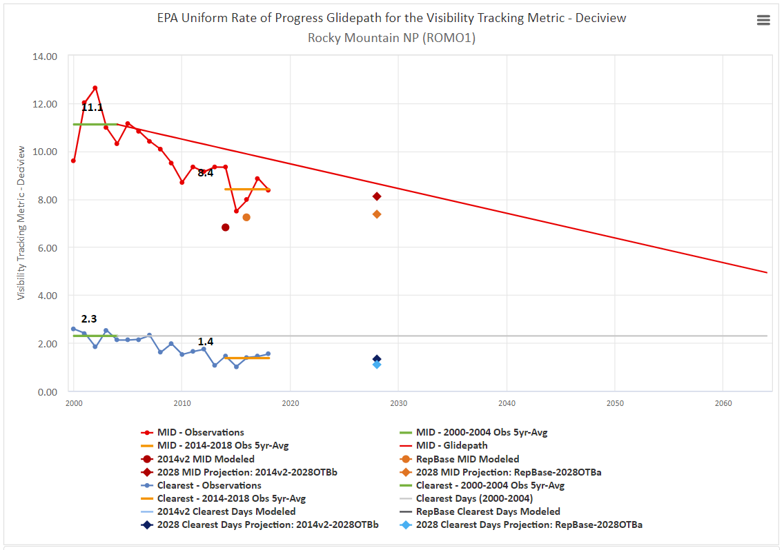
Workplan Product Results by RTOWG
Adjusted URP that accounts for international and prescribed wildland fires (ESTIMATED -NOT FINAL)
Contribution from international and Rx fire
Unadjusted URP
From: “Adjusting the URP Glidepath Accounting for International Anthropogenic Emissions and Prescribed Fires using the WRAP 2014/2028 Modeling Platform Results (July 24, 2020 draft)” on RTOWG webpage

Slide 8
Workplan Product Results by RTOWG
Potential Additional Controls, Round #1 (PAC1)
As expected, very small changes in projected 2028 MID dv
Mostly hundredths of dv changes
Largest changes in or near states with emissions reductions (e.g., NM, AZ, ND)
Smallest changes away from such states (e.g., CA)
Round 2 of Potential Additional Controls (PAC2)
Need state emission changes to be tested by Sept. 10, 2020
Caveats:
2028OTB emissions include double counted O&G sources
In both 2028OTBa and 2028PAC1
Does not affect the reductions in 2028 MID due to PAC1 controls
Probably minimal affect on 2028 MID projections

Slide 9
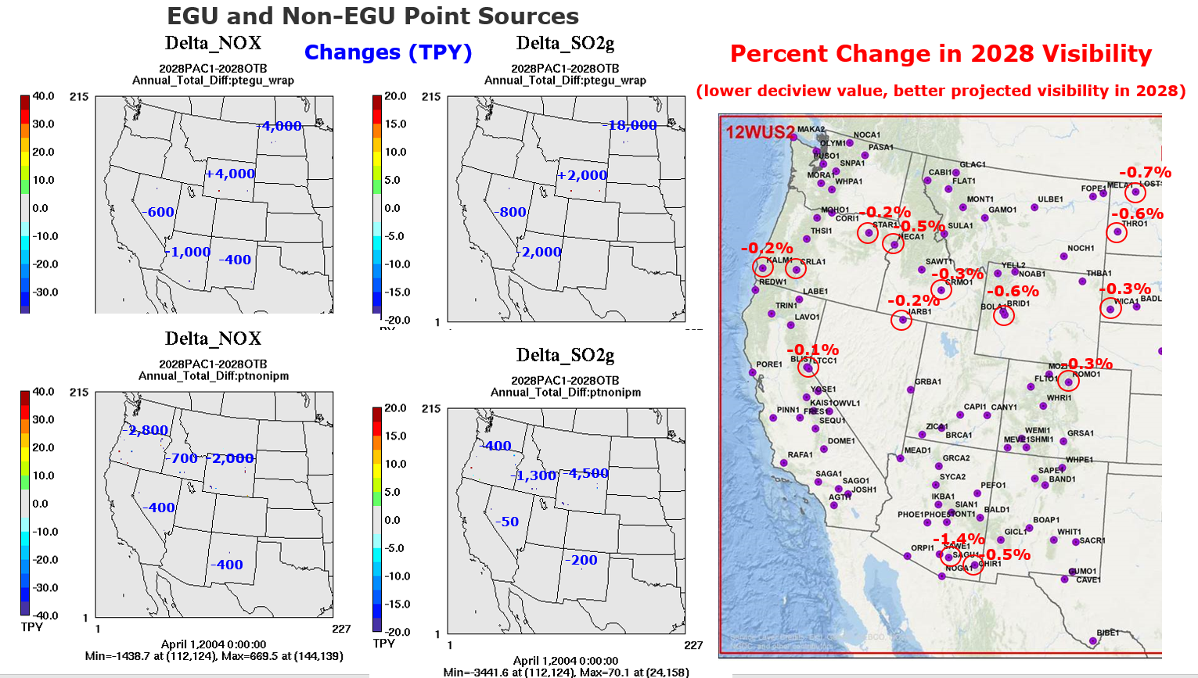

Slide 10
Upcoming Work by RTOWG
Workplan Tasks for the Next Two Months
Assuming all state updates on 2028 emissions are provided by July 21st in FF10 format:
2028OTBa2 SMOKE emissions modeling finished by August 4
CAMx 2028OTBa2 standard model run finished by August 11
Revised 2028OTBa2 projections on TSS by August 13
CAMx 2028OTBa2 high-level source apportionment run finished by August 31
U.S. vs. International anthropogenic, fires and natural contributions
Adjust URP Glidepath for International Emissions and Wildland Prescribed Fires
Use for Dynamic Evaluation U.S. anthropogenic emissions extinction Glidepath from 2002 to zero in 2064 with 2016 (RepBase) and 2028 (OTBa2) visibility projections
CAMx 2028OTBa2 low-level source apportionment run finished in October
State-specific and Source Sector-specific contributions

Slide 11
Updates to 2028OTBa2 emission inventory

Slide 12
Regional Haze Planning Work Group
Verbal Update Only

Slide 13
Workplan Progress by RHPWG EIMP SC
Workplan Progress over the Last Month
Added task to provide model-input and NEI emissions summaries by model sector.
2028 OTB double counting necessitated review of O&G and non-EGU. States provided updates for the 2028 OTB emissions. This scenario will be rerun.
Workplan Tasks for the Next Two Months
Contractor will continue to provide deliverables
PACv2 Emissions Submittals due in August.

Slide 14
End of Workplan Progress Update

